Slide 1
PFA Housing Project
Submitted By:- Sujay Nimbalkar
Submitted To:- Swati Mahaseth
(FLIP ROBO TECHNOLOGIES)
13/02/2022.

Slide 2


Slide 3
Firstly we have imported data set we have 1168 rows and 68 columns. Once importing we have started with Exploratory Data Analysis in which we have seen the shape,types,columns. We have also checked the unique values in the data set. Here we came to know that the sales column is our dependant variable and is in continuous nature hence we conclude that this is a linear regression problem

Slide 4
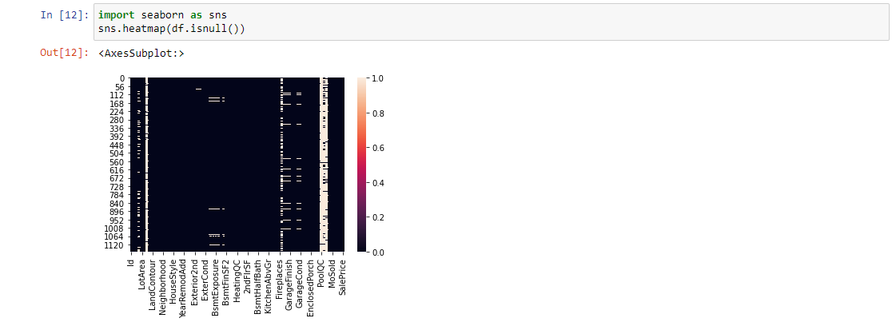
We have also plotted the Heat map to check the Null Values in the dataset

Slide 5
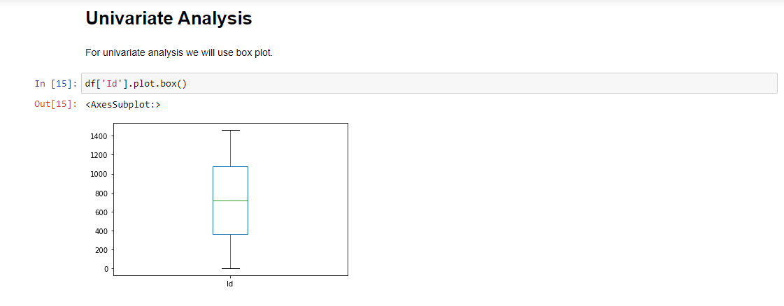
We have done Unvariate Analysis with each of the column by using with Box Plot Which gave us the detailed information

Slide 6
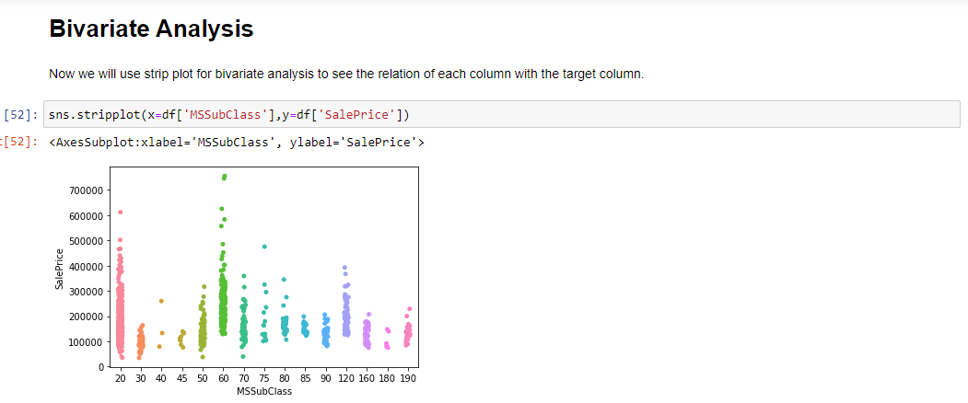
Bivariate Analysis using strip plot to see the relation of the each column with target column

Slide 7
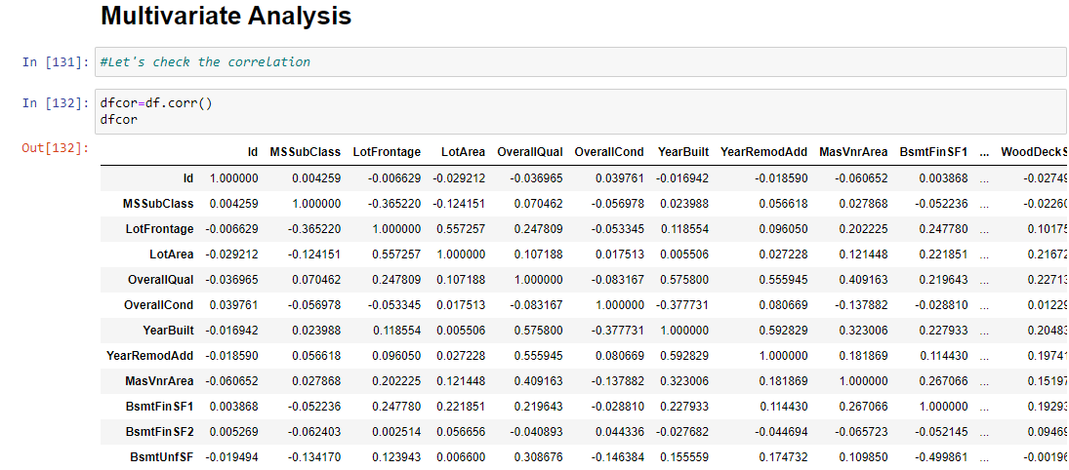
Multivariate Analysis to check the co-relation

Slide 8
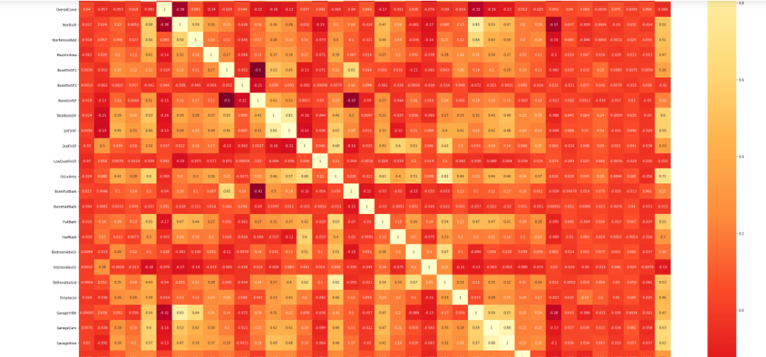
Heat Map for co-relation

Slide 9
Key Observations
Now we can clearly indentify the correlation of independent variable with the target variable"SalePrice" . The variables which has values less than 0.01 have weak correlation with the target variable, while the variables which has value more than have strong relation with the target column.

Slide 10
Checking the skewness,removing the skewness,data cleaning,label encoding and creating train,test,split
We have also checked the skewness removed the skewness cleaned the data in which we have dropped highly negative column which were not required and after that we have also done the label encoding in which we have converted the column into integer format

Slide 11
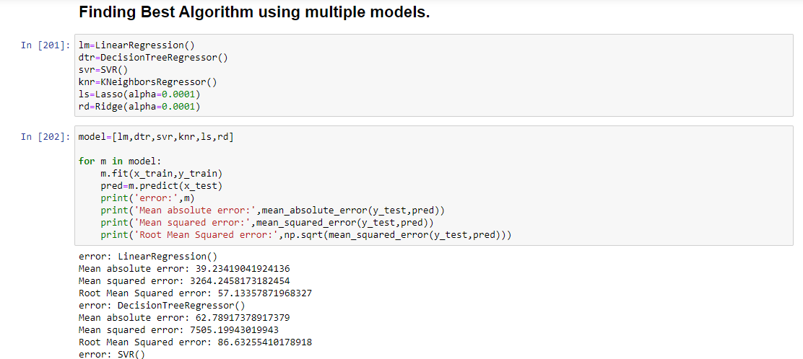
Finding the best Model using multiple Algorithms

Slide 12
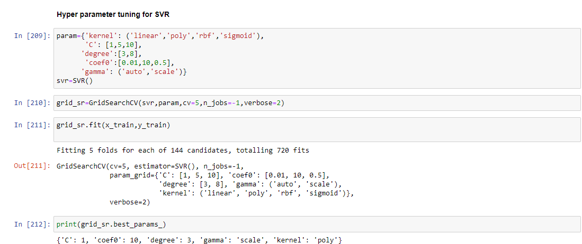
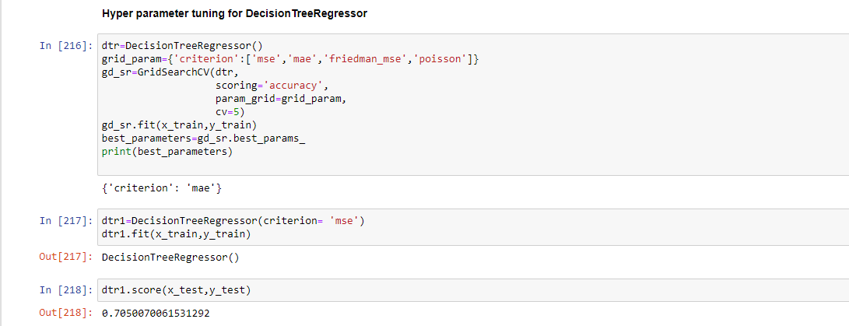
Hyperparameter Tuning with SVR which is giving good score than Decision Tree Regressor

Slide 13
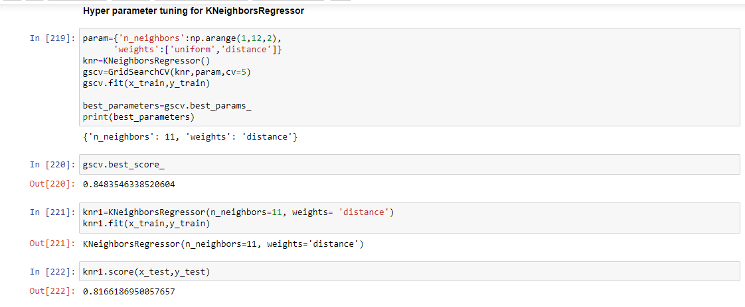
Hyperparameter Tuning with Kneighbour regressor giving accuracy score of 81%

Slide 14
Saving Best Model
Hence we conclude and selected the SVR as our best model as it is giving the best accuracy score after hyperparameter tuning with SVR
Hence that is our best model

Slide 15
THANK YOU

